Slide 1



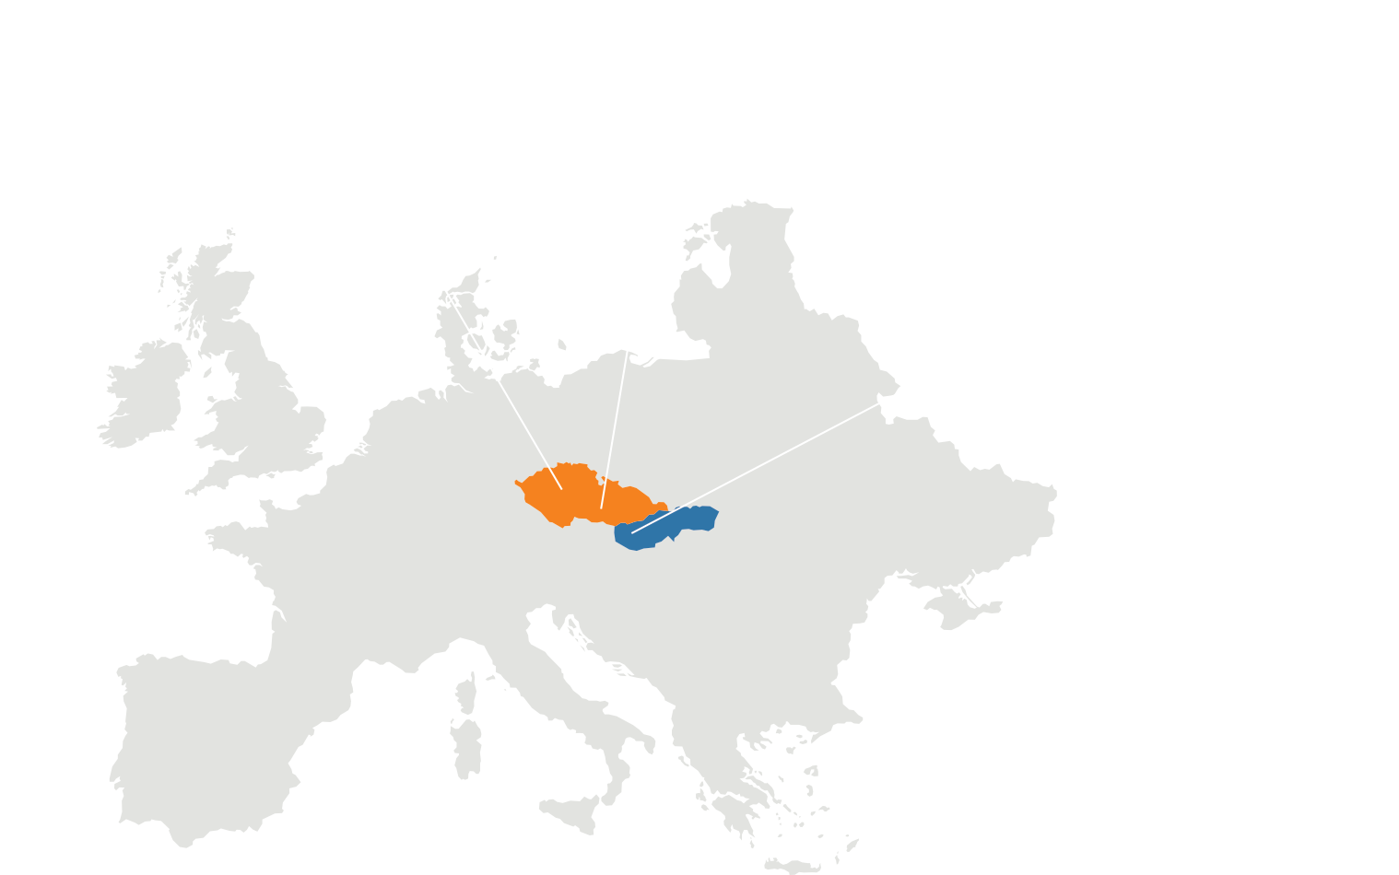




ERP
CRM
BI
AL Development Project
DMS
Tiffany Elias
Software Developer
05. 05. 2025
AI
34
37

Slide 2
ERP
Table of Contents
CRM
Introduction
What is AL language
What is BC
Logo and Documents
Tables
Enums
Codeunits
Extensions
Pages
Reports
Permission Sets
Tests
README.md
GitHub
BI
DMS
AI
Conclusion
34
37

Slide 3
ERP
CRM
BI
Introduction
DMS
AI
34
37

Slide 4
ERP
Introduction
CRM
This project implements a custom navigation framework within Microsoft Dynamics 365 Business Central,
designed to provide users with a simplified, centralized interface for navigating between key business areas such
as Customers, Vendors, Items, Sales, and Finance.
Using a combination of Enums, Codeunits, and custom Pages, the solution allows users to select a category from
a predefined list and seamlessly navigate to the corresponding list page. The core navigation logic is encapsulated
in a handler codeunit, making it easy to manage, extend, and test. A dedicated card page (Customer Ext) serves as the main menu interface, offering both dynamic navigation based on user selection and quick access actions for each module.
BI
DMS
AI
34
37

Slide 5
ERP
CRM
BI
What is AL language
DMS
AI
34
37

Slide 6
ERP
CRM
What is AL language
BI
AL (Application Language) is a programming language developed by Microsoft specifically for customizing and extending Microsoft Dynamics 365 Business Central. It replaced the older C/AL (C/SIDE) language and is designed to work with
Visual Studio Code through an extension provided by Microsoft. AL allows developers to create business logic, custom pages, reports, and integrations tailored to the unique needs of a small business.
DMS
AI
34
37

Slide 7
ERP
CRM
What is Microsoft Dynamics 365 Business Central (BC)
BI
DMS
AI
34
37

Slide 8
ERP
What is Microsoft Dynamics 365 Business Central (BC)
CRM
BI
Business Central (BC) is an Enterprise Resource Planning (ERP) solution developed by Microsoft. It is part of the Dynamics 365 product line and is designed to help small and medium-sized businesses (SMBs) manage their operations across finance, sales, service, supply chain, manufacturing, and more, all in one integrated platform.
DMS
AI
34
37

Slide 9
ERP
CRM
BI
Logo and Documents
DMS
AI
34
37

Slide 10
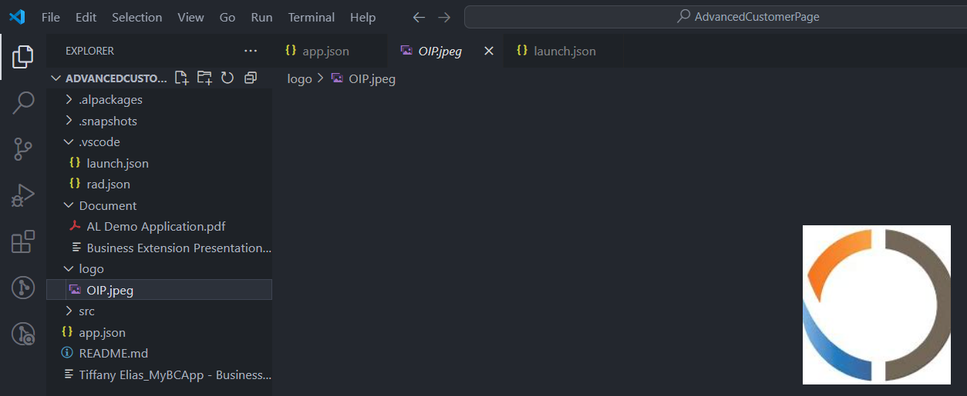
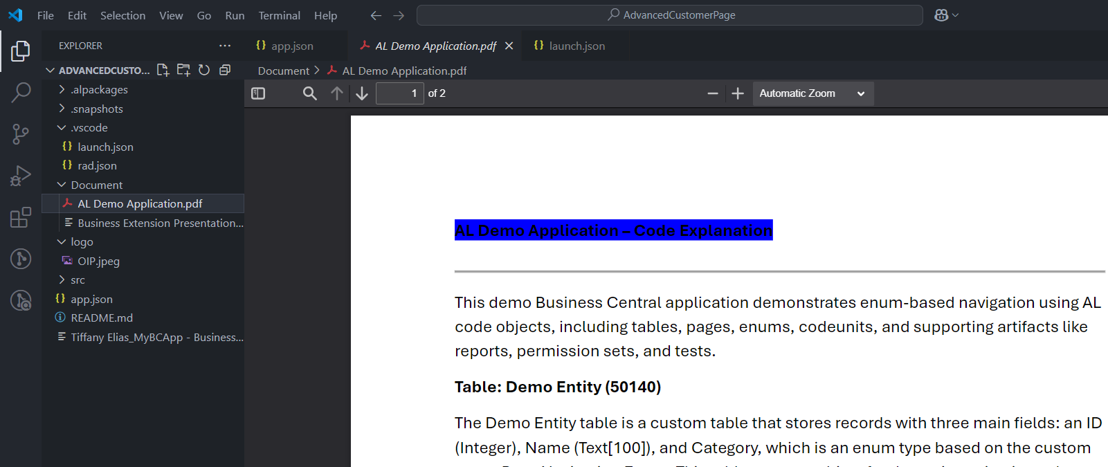
ERP
Logo and Documents
CRM
BI
DMS
AI
34
37

Slide 11
ERP
CRM
BI
Tables
DMS
AI
34
37

Slide 12
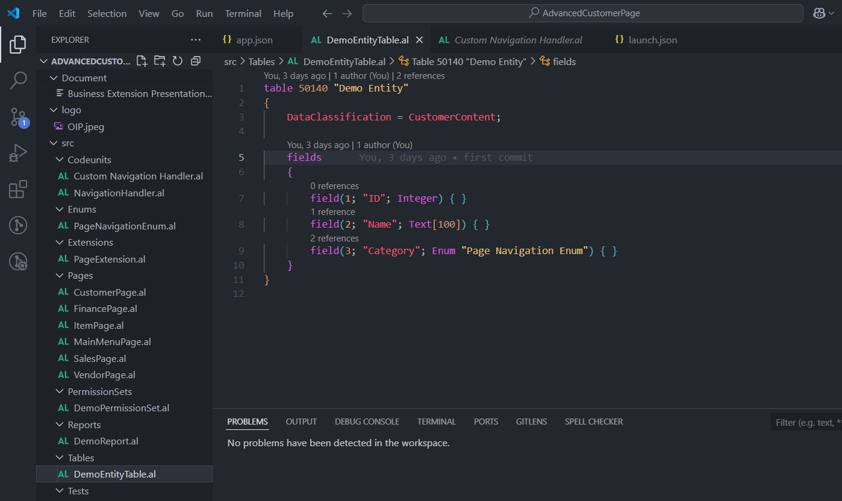
ERP
Tables
CRM
Purpose: Stores navigation-related entities. Each record has a name and a category for navigation,
using an Enum to determine where it should navigate.
Fields:
ID: Unique identifier (Integer).
Name: Name of the entity (Text[100]).
Category: Enum field of type Page Navigation Enum.
How it works: The Category field determines which page to navigate to from the Customer Ext page using the Enum values.
BI
DMS
AI
34
37

Slide 13
ERP
CRM
BI
Enums
DMS
AI
34
37

Slide 14
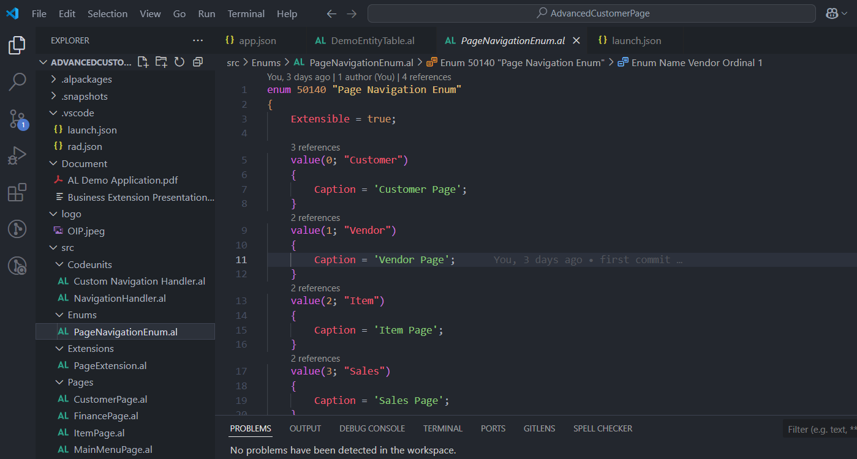
ERP
Enums
Purpose: Defines fixed values for possible pages to navigate to, such as Customer, Vendor, Item,
Sales, and Finance.
Values:
Customer: Navigates to the Customer page.
Vendor: Navigates to the Vendor page.
Item: Navigates to the Item page.
Sales: Navigates to the Sales Order page.
Finance: Navigates to the G/L Entry page.
Usage: This Enum is used by the navigation handler to determine the direction page.
CRM
BI
DMS
AI
34
37

Slide 15
ERP
CRM
BI
Codeunits
DMS
AI
34
37

Slide 16
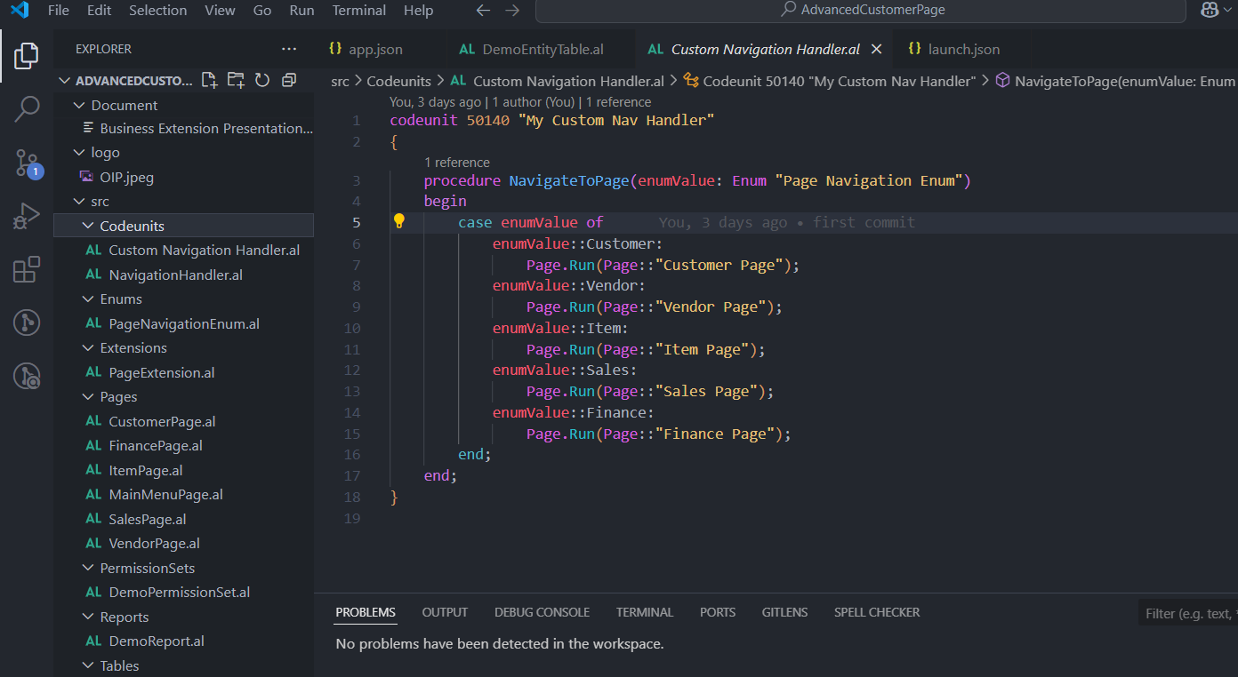
ERP
Codeunits
CRM
Purpose: Handles navigation logic using the Enum value.
Main Procedure:
Navigate To Page(Enum Value: Enum "Page Navigation Enum")
Uses a case statement to decide which page to open based on the Enum value.
BI
DMS
AI
34
37

Slide 17
ERP
CRM
BI
Extensions
DMS
AI
34
37

Slide 18
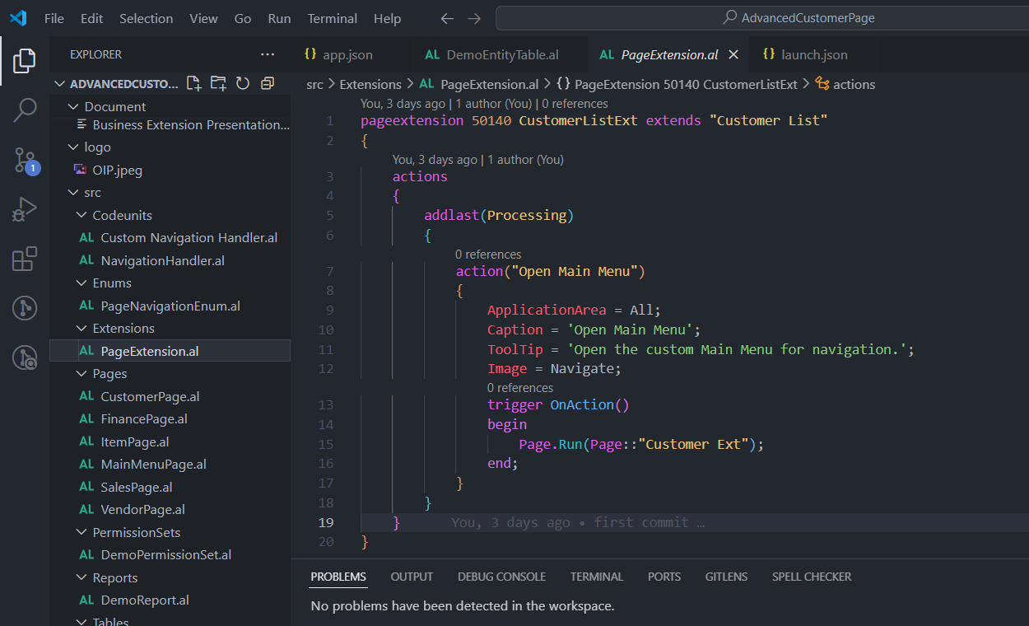
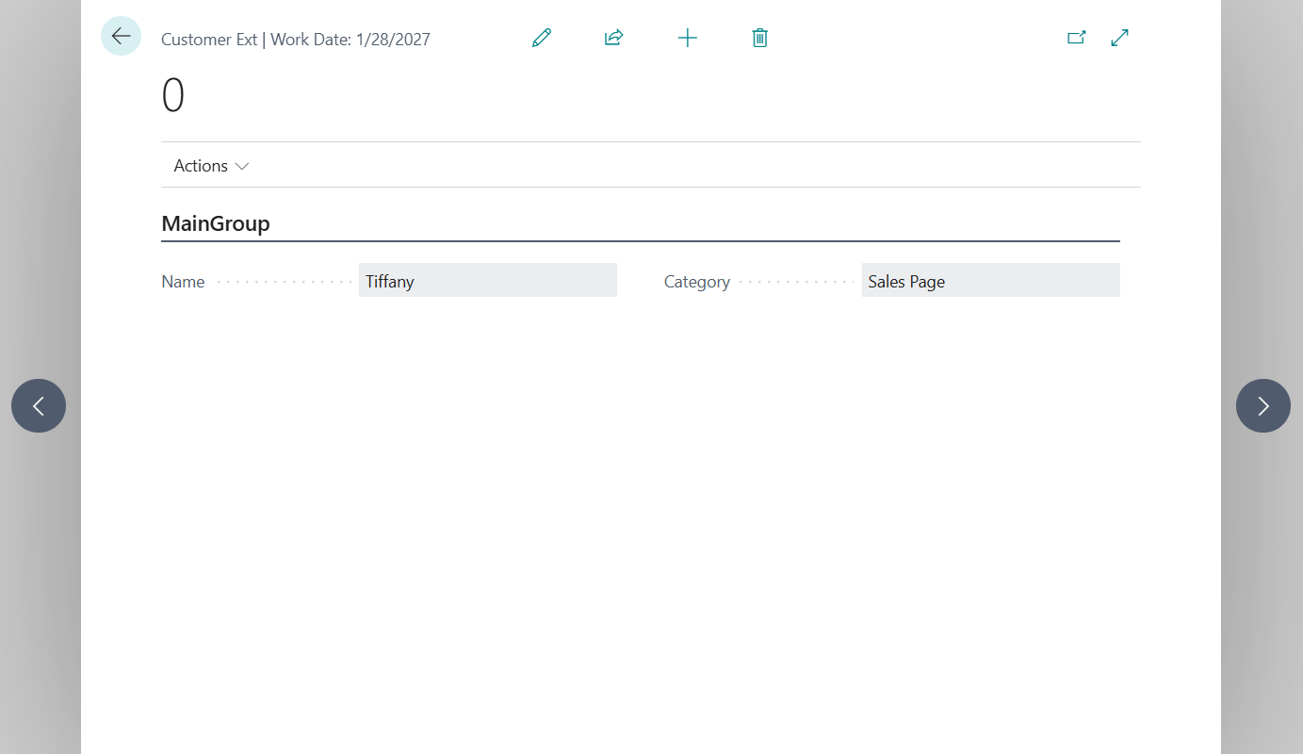
ERP
Extensions
CRM
Purpose: Adds a custom action button "Open Main Menu" to the Customer List page.
How it works:
When clicked, it opens the Customer Ext page which allows users to choose a category and trigger navigation.
BI
DMS
AI
34
37

Slide 19
ERP
CRM
BI
Pages
DMS
AI
34
37

Slide 20
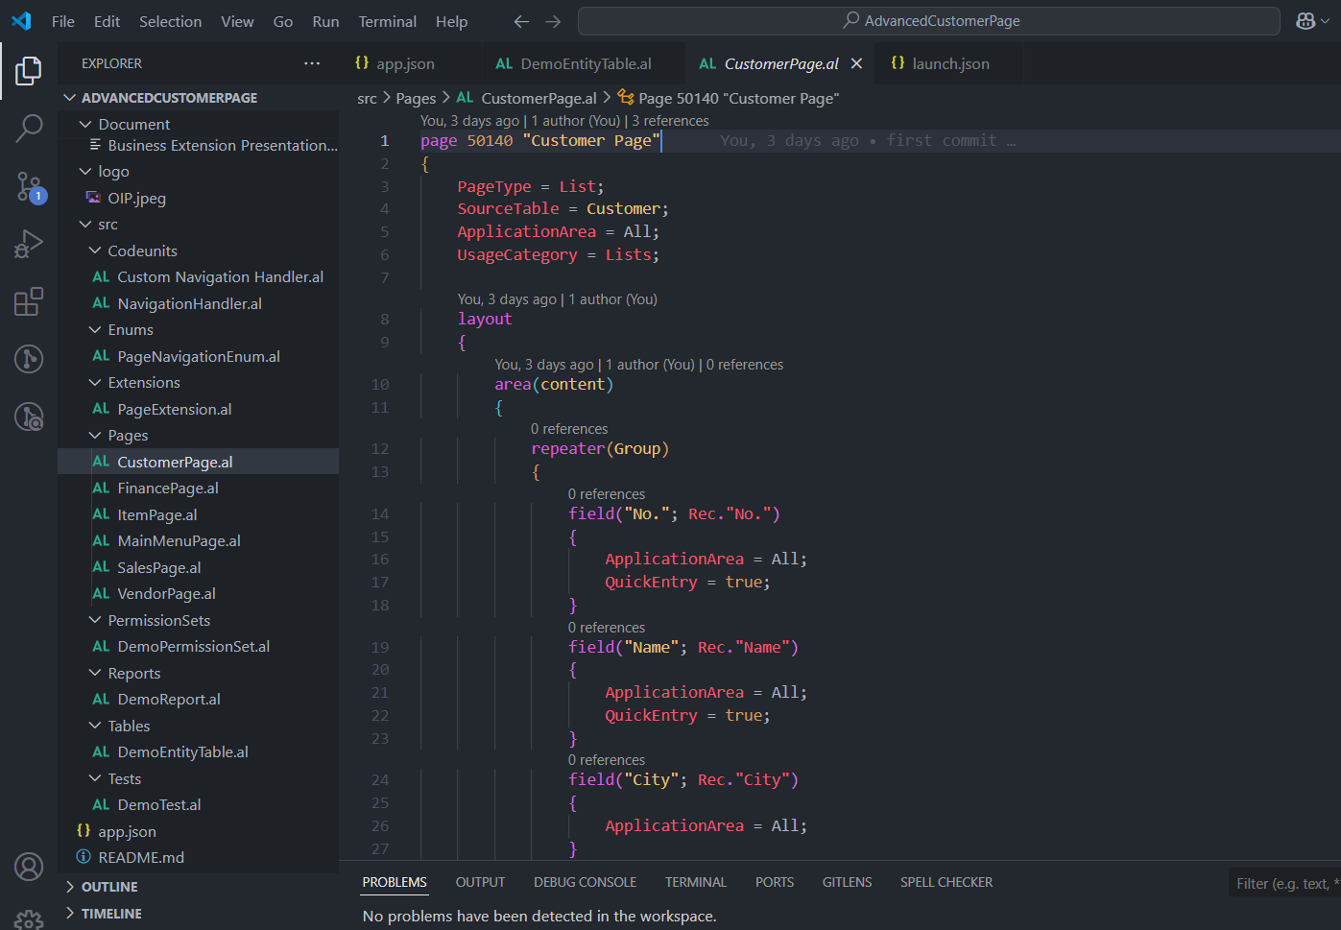
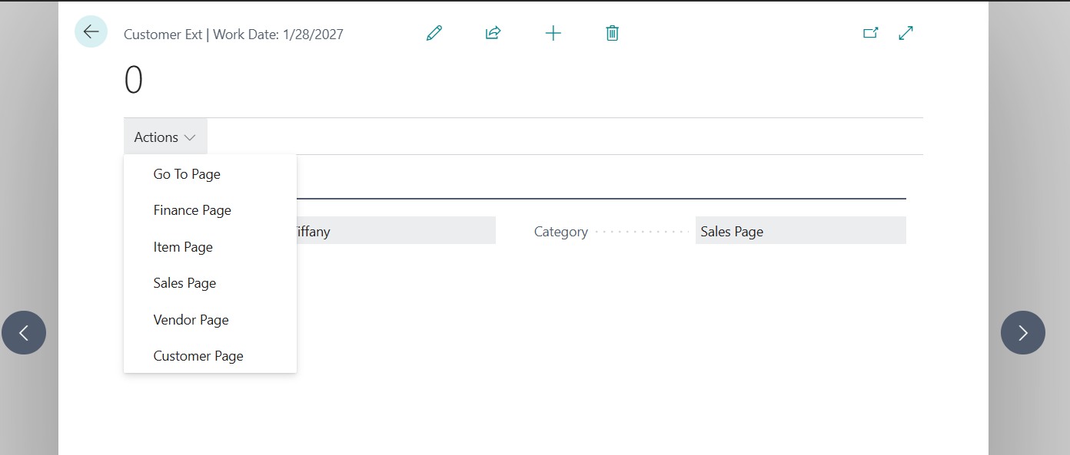
ERP
Pages
CRM
Purpose: Card page that allows users to:
Select a name and navigation category.
Click actions to go to different pages either using the Enum logic (GoToPage) or directly (e.g., OpenCustomerPage).
Fields:
Name: Name of the custom entity.
Category: Navigation category (Enum).
Actions:
GoToPage: Calls the navigation handler code unit to open
the selected page.
Additional direct actions for Finance, Vendor, Sales, etc.
BI
DMS
AI
34
37

Slide 21
ERP
CRM
BI
Reports
DMS
AI
34
37

Slide 22
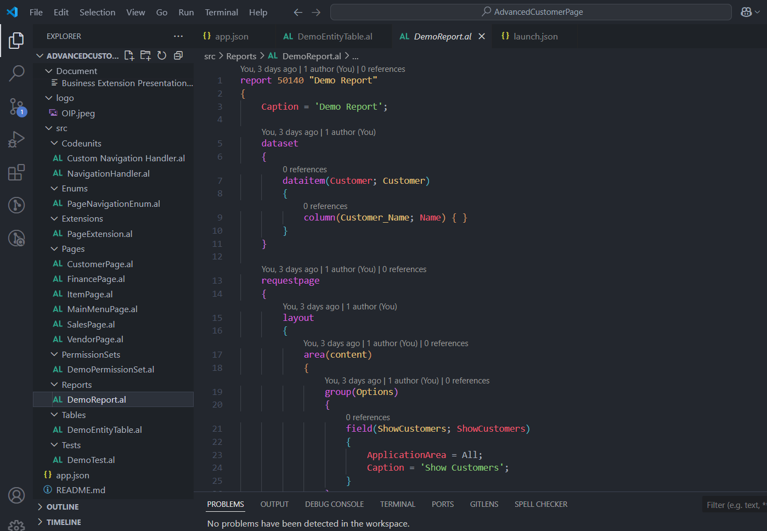
ERP
Reports
CRM
Purpose: Simple report that lists customer names, optionally filtered by a Boolean toggle (ShowCustomers).
Structure:
data item: Customer
request page: Has a checkbox to determine whether to show customer data.
BI
DMS
AI
34
37

Slide 23
ERP
CRM
BI
Permission Sets
DMS
AI
34
37

Slide 24
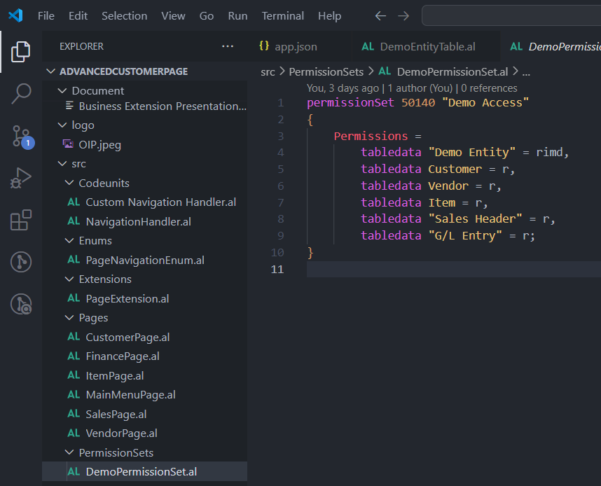
ERP
Permission Sets
CRM
Purpose: Grants access to the demo data and standard data used in the app.
Permissions:
Full access (rimd) to Demo Entity.
Read access (r) to: Customer, Vendor, Item, Sales Header, G/L Entry.
BI
DMS
AI
34
37

Slide 25
ERP
CRM
BI
Test
DMS
AI
34
37

Slide 26
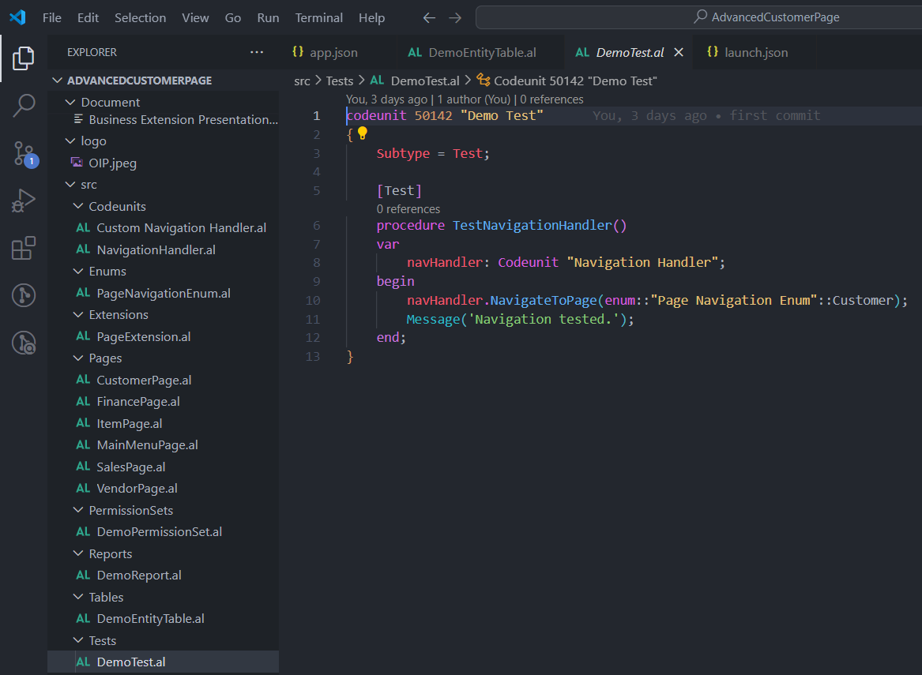
ERP
Test
CRM
Purpose: Verifies that the navigation logic works without errors.
Test Procedure:
TestNavigationHandler: Calls the NavigateToPage
method with Customer as the input Enum.
Output: Displays a message confirming that the navigation
logic has been executed.
BI
DMS
AI
34
37

Slide 27
ERP
CRM
BI
README.md
DMS
AI
34
37

Slide 28
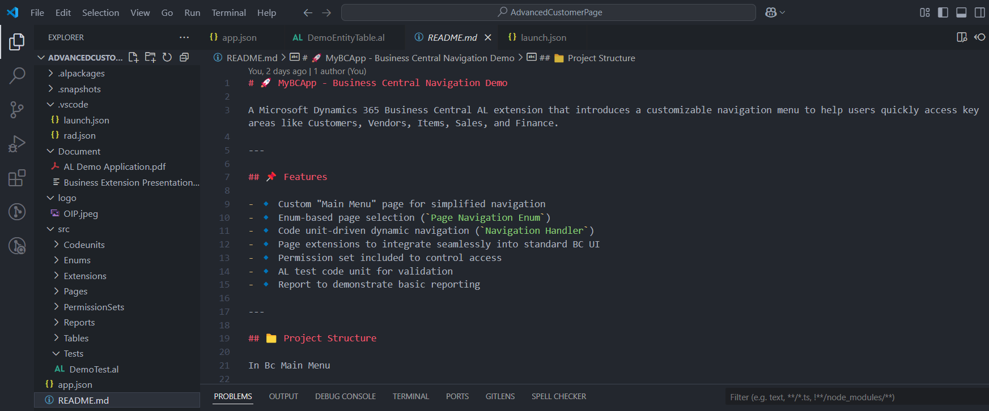
ERP
README.md
CRM
BI
DMS
AI
34
37

Slide 29
ERP
CRM
BI
GitHub
DMS
AI
34
37

Slide 30
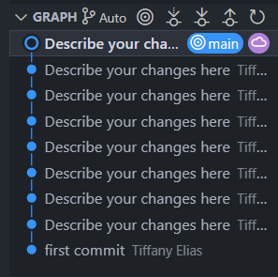
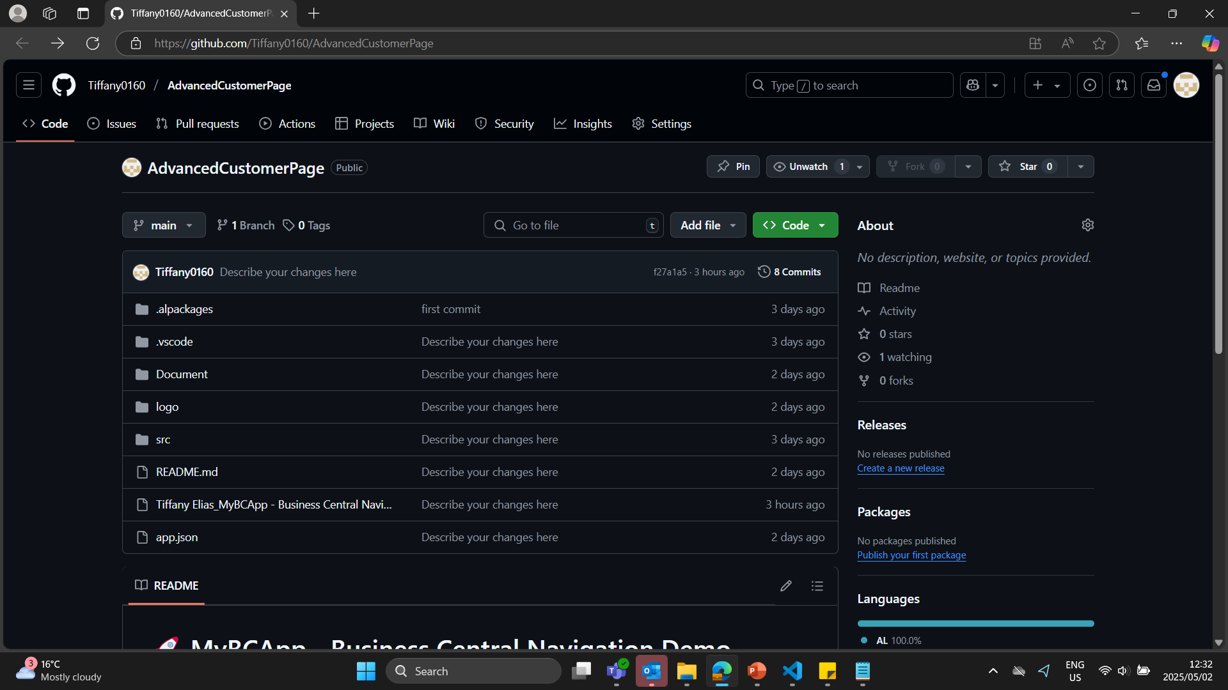
ERP
GitHub
CRM
BI
DMS
AI
34
37

Slide 31
ERP
CRM
BI
Conclusion
DMS
AI
34
37

Slide 32
ERP
Conclusion
CRM
This custom navigation solution provides a robust and user-friendly framework for simplifying the user experience in Microsoft Dynamics 365 Business Central. By leveraging Codeunits, Enums, and custom Pages, the project enables efficient navigation between key business areas, offering a streamlined approach for users to access important modules such as Customers, Vendors, Items, Sales, and Finance.
The flexibility of this system makes it adaptable to various business needs, allowing for easy extension and customization. It can be integrated as a role center alternative, a main menu interface, or a tailored navigation tool in both standard and ISV solutions. The inclusion of a test codeunit ensures that the navigation logic functions correctly, while the permission set provides secure access to the necessary data.
Ultimately, this project not only enhances the user experience within Business Central but also demonstrates how to build modular, scalable solutions that can be adapted as business requirements evolve. By centralizing navigation logic, it simplifies maintenance and fosters greater agility in the system.
BI
DMS
AI
34
37

Slide 33


